Slide 1
Online Technology
Convert Spending to Earning

Slide 2
What is the
Home Advisor?

Slide 3
Online Application that completes the Home Shopping List, MyList, Auto-Ship/TB and Checkout in ONE process.
Assists you in identifying products you are currently buying from somewhere else monthly and periodically.
Provides value comparisons between our most popular ma Branded products and competitive brands.
It saves you time, money and earns you more commissions.

Slide 4
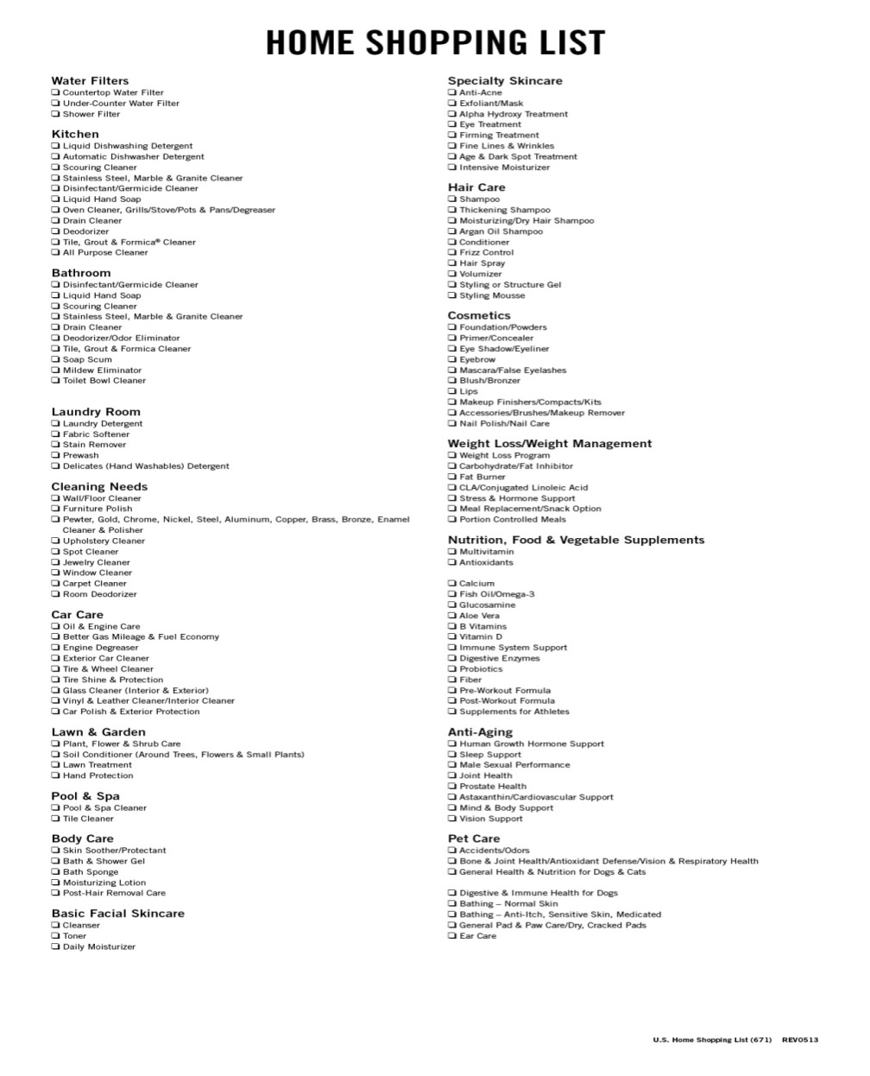
Home Advisor
It saves you time:
No longer do you have to fill out a paper form then go online and search for the products individually and then add them to your MyList one by one.

Slide 5
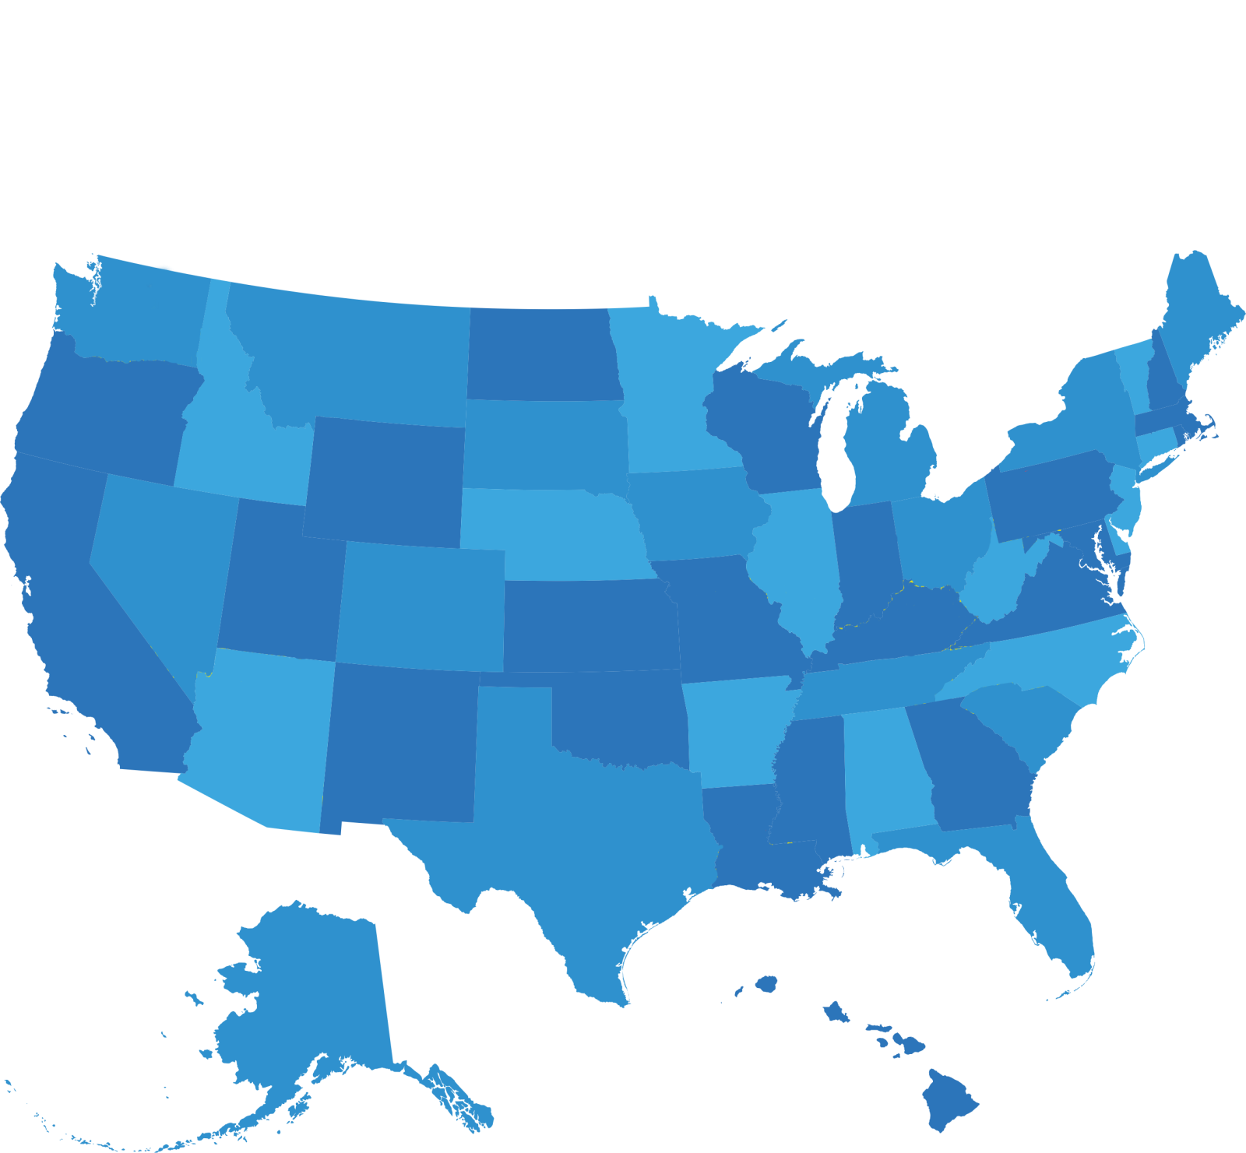
Easy Long Distance Connecting
Home Advisor

Slide 6
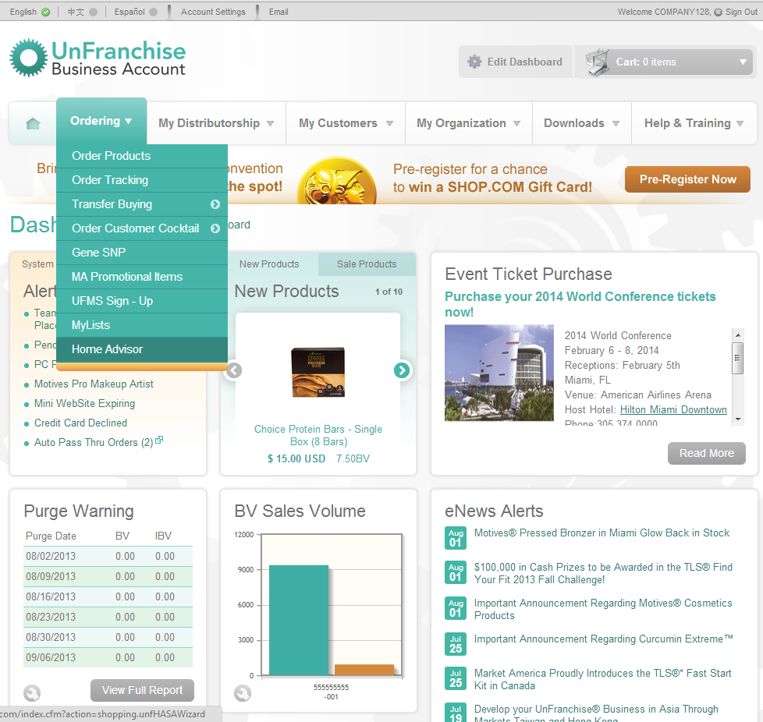

Slide 7
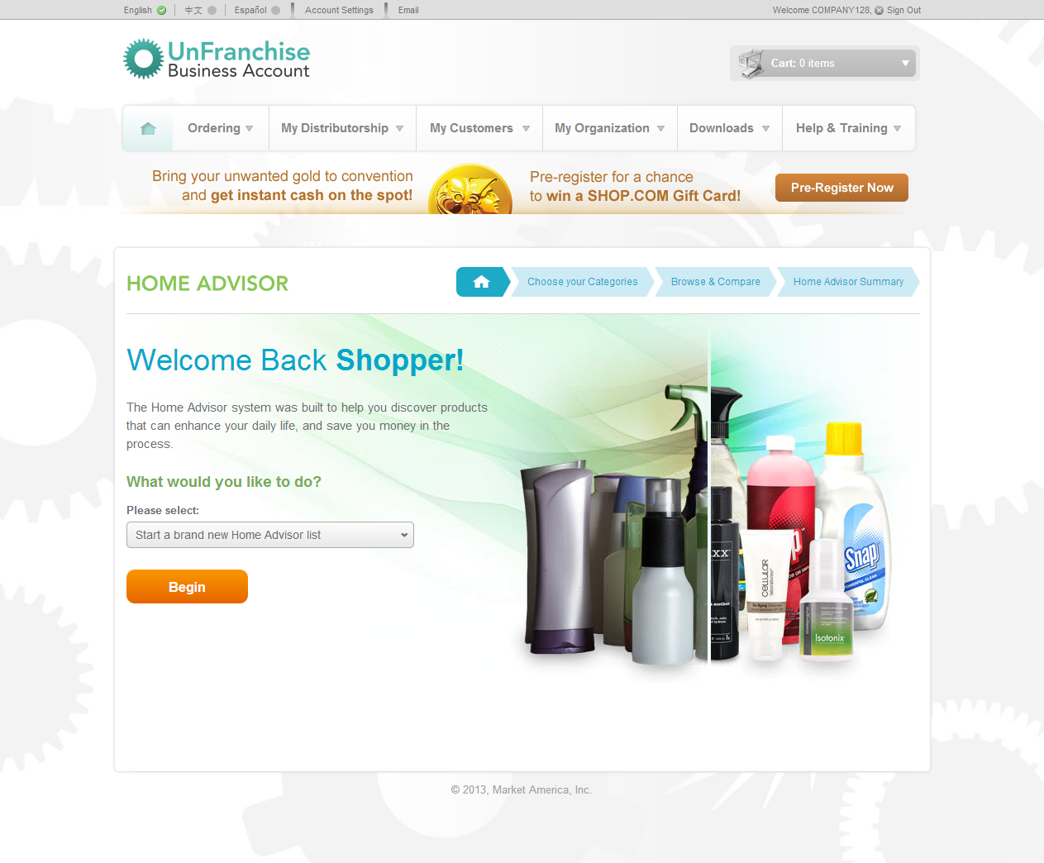

Slide 8
Select the categories that
fit your houshold.
For Him, Her, Child, Pet,
Pool/Spa, Vehicle or Lawn & Garden

Slide 9
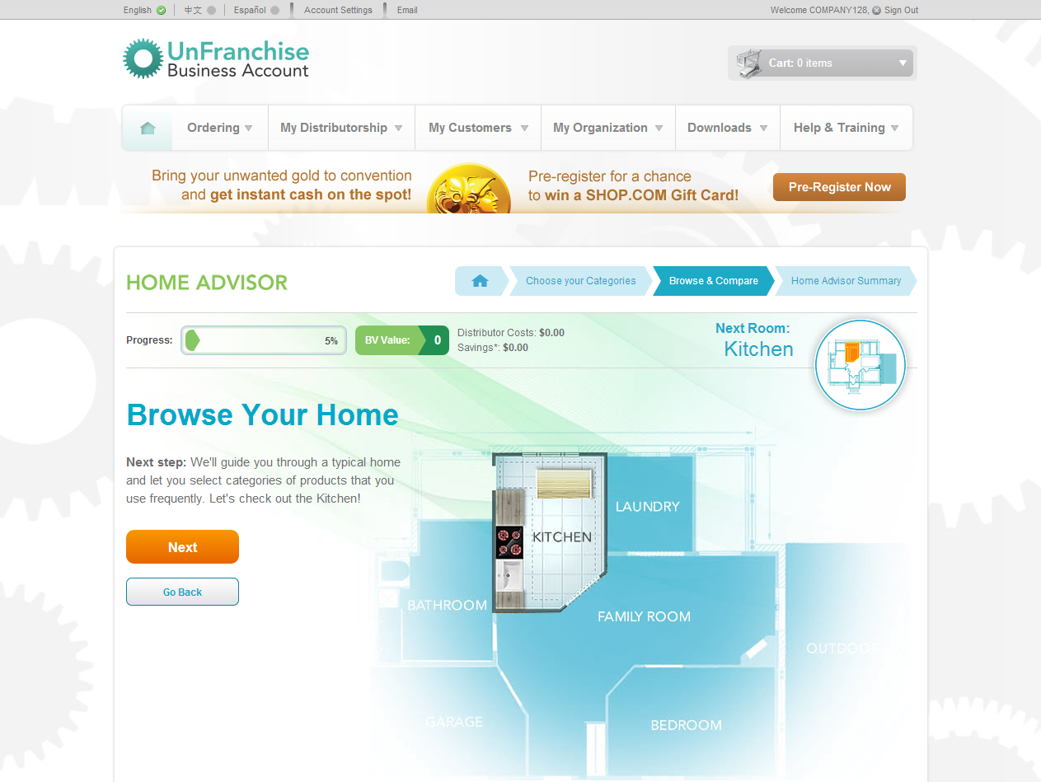

Slide 10
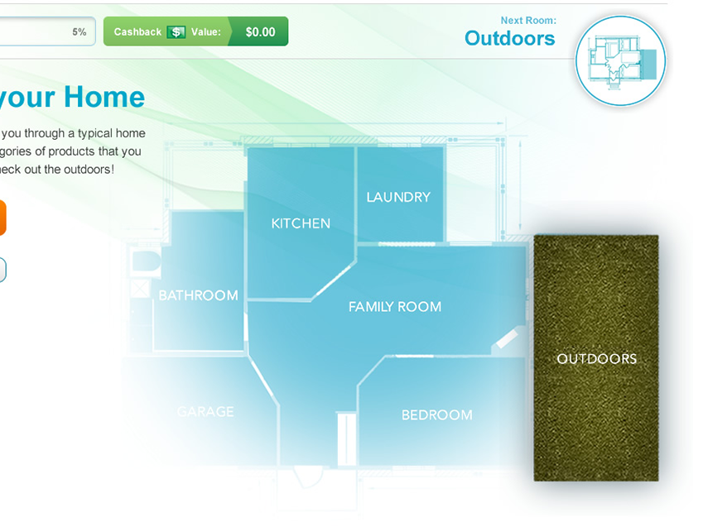
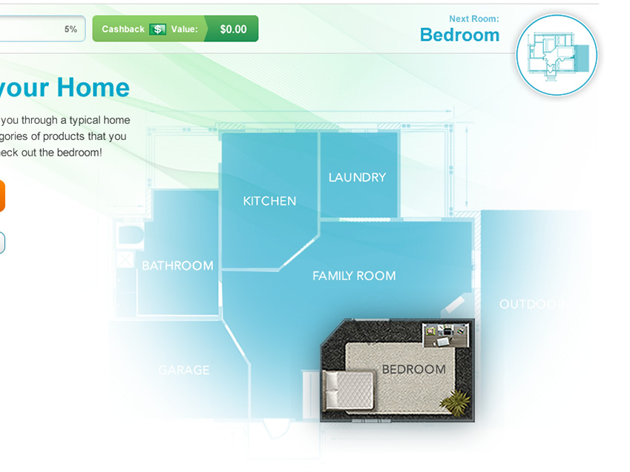
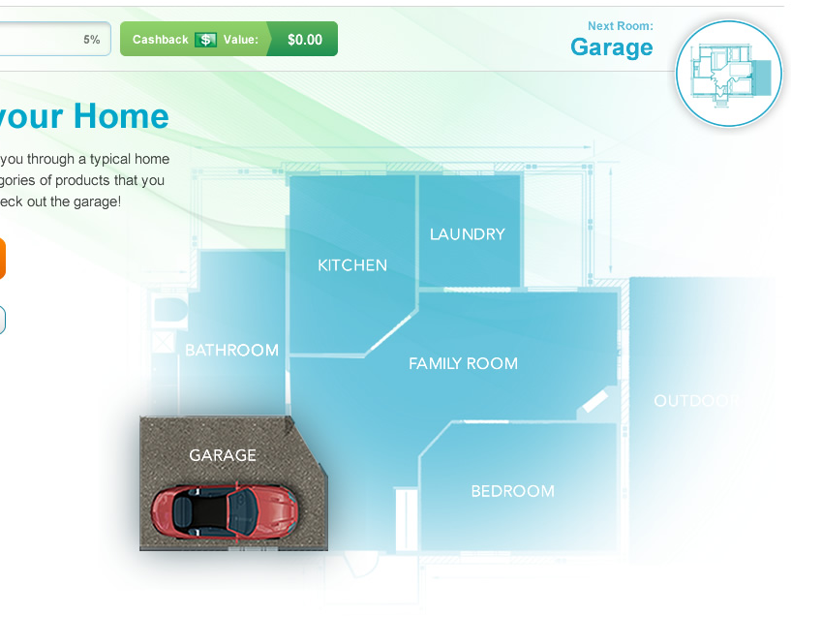
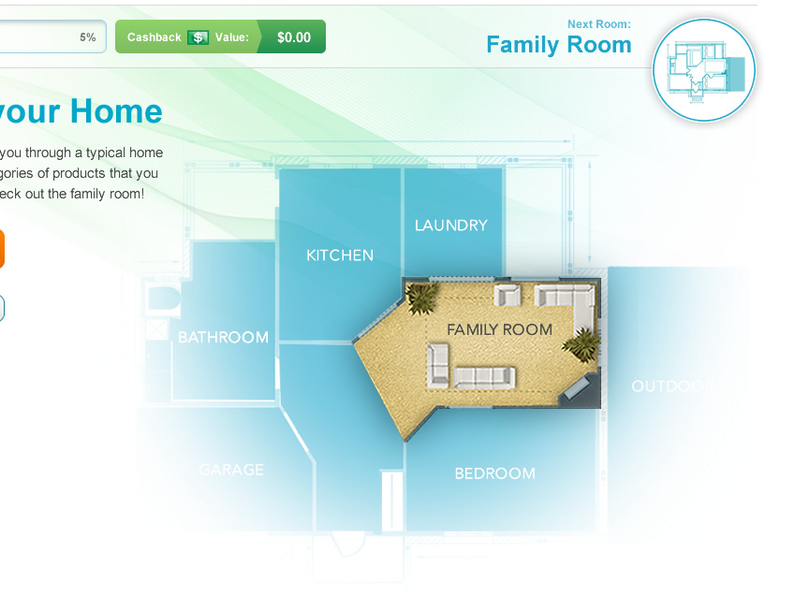
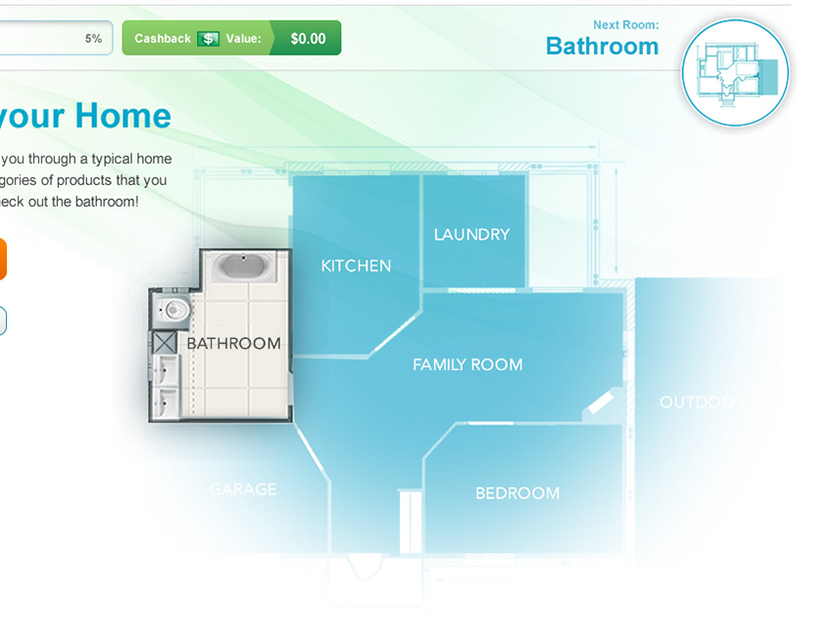
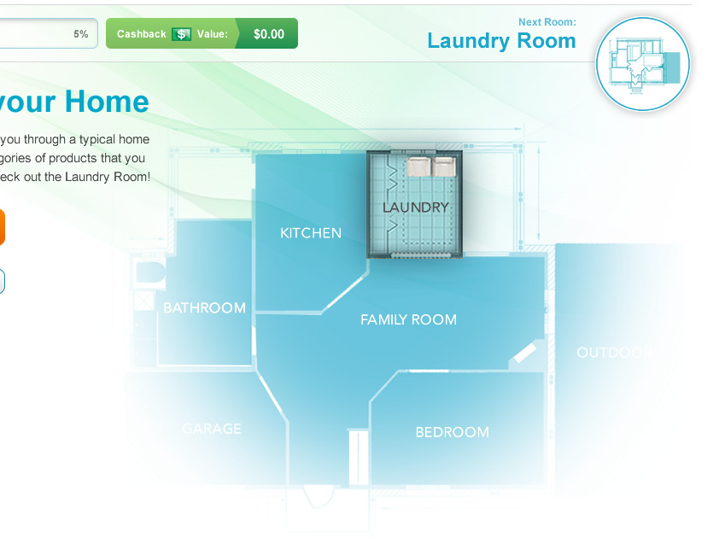

Slide 11
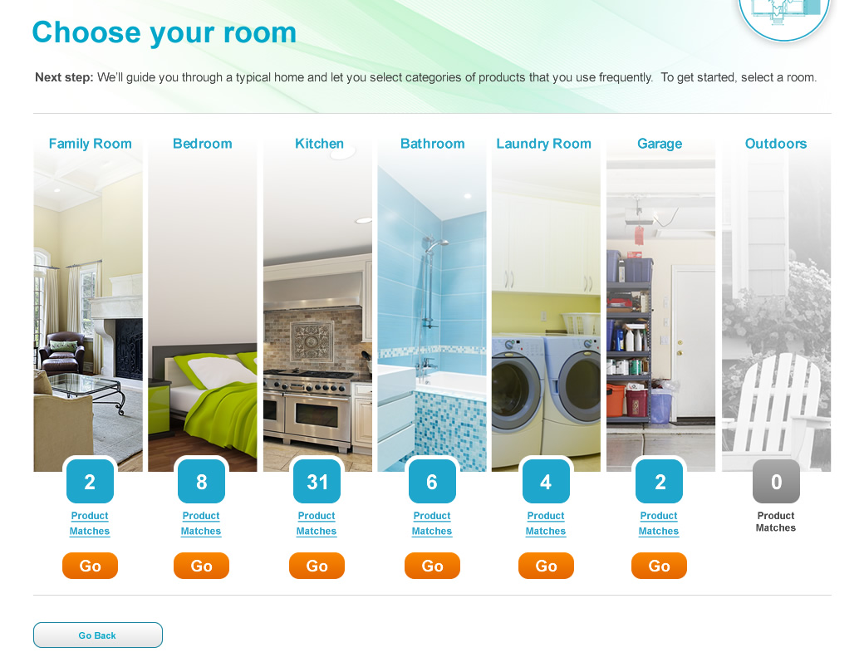

Slide 12
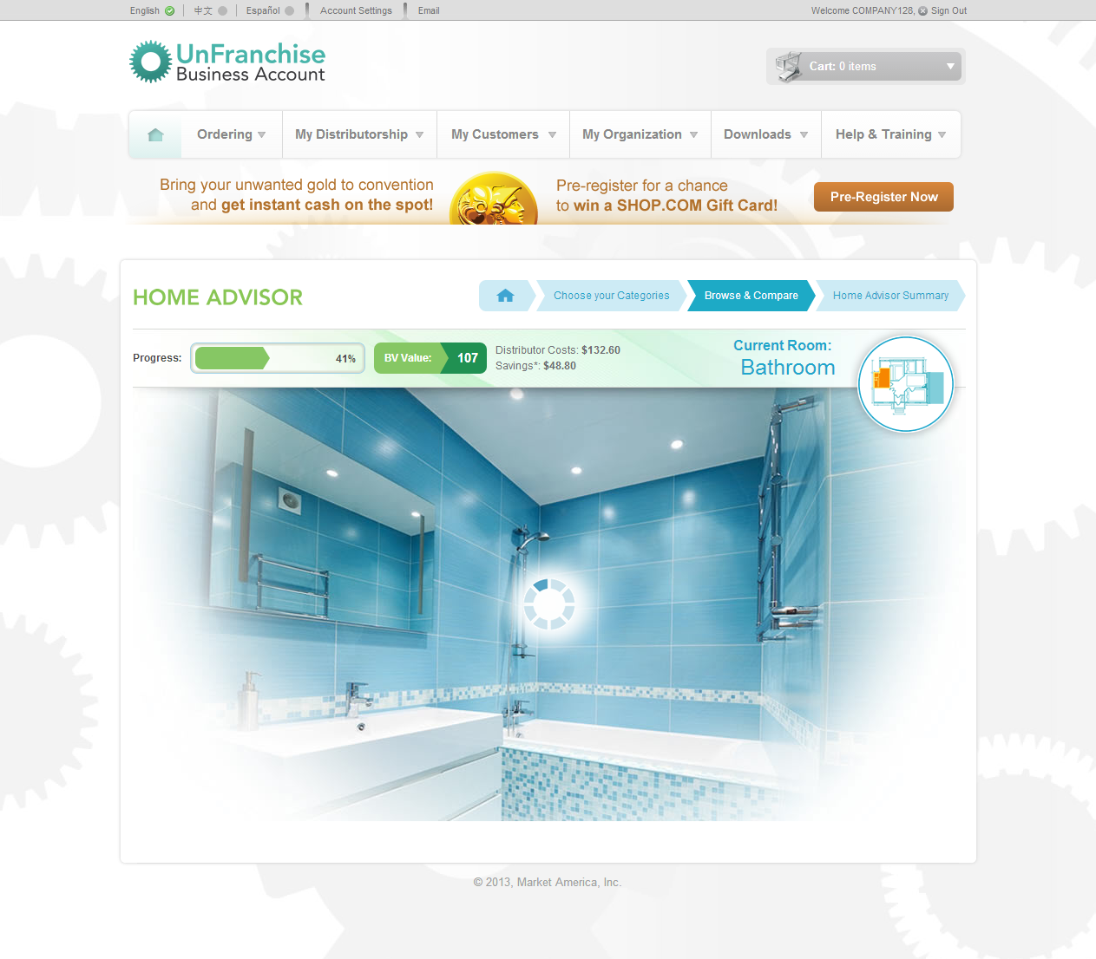
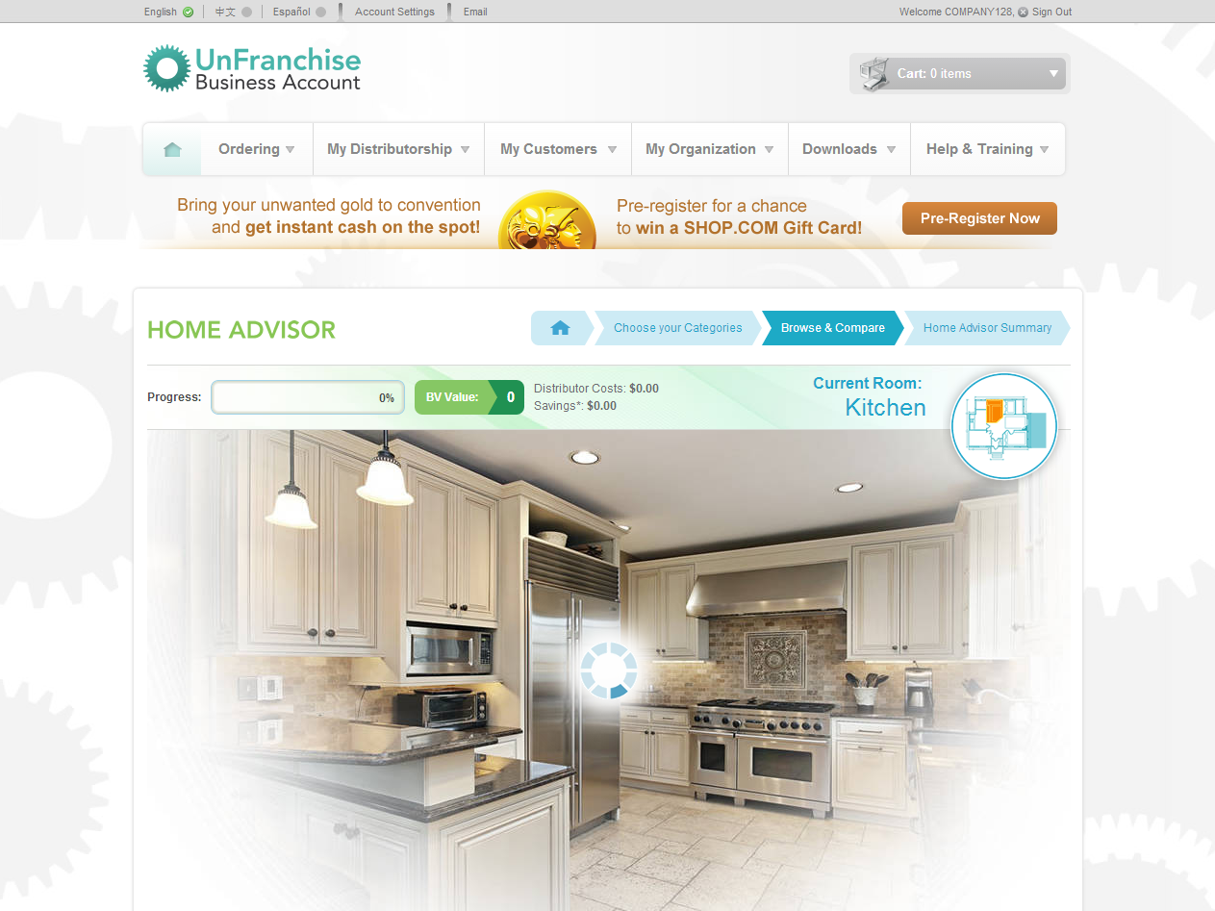

Slide 13
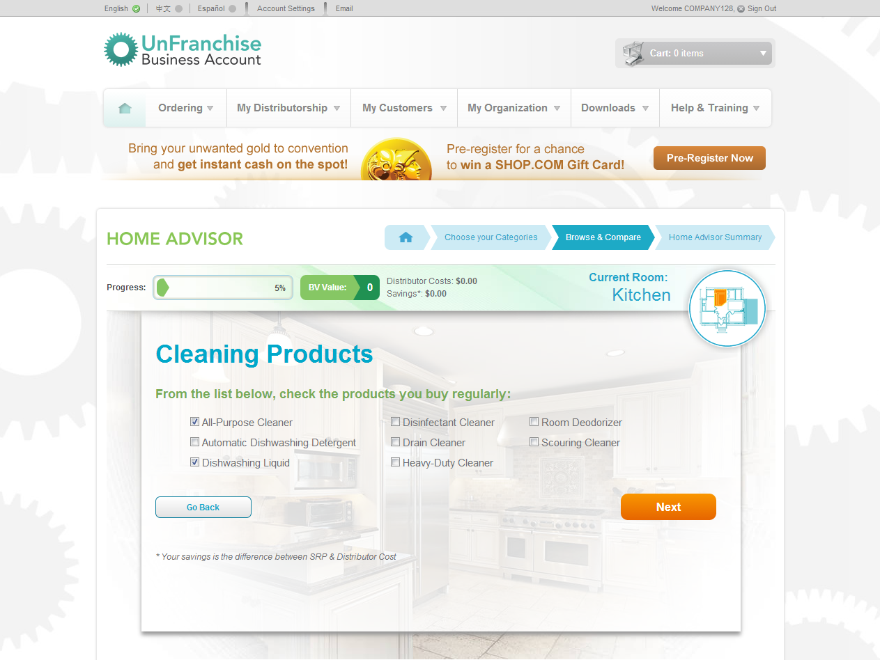
Get rid of your negative products!

Slide 14
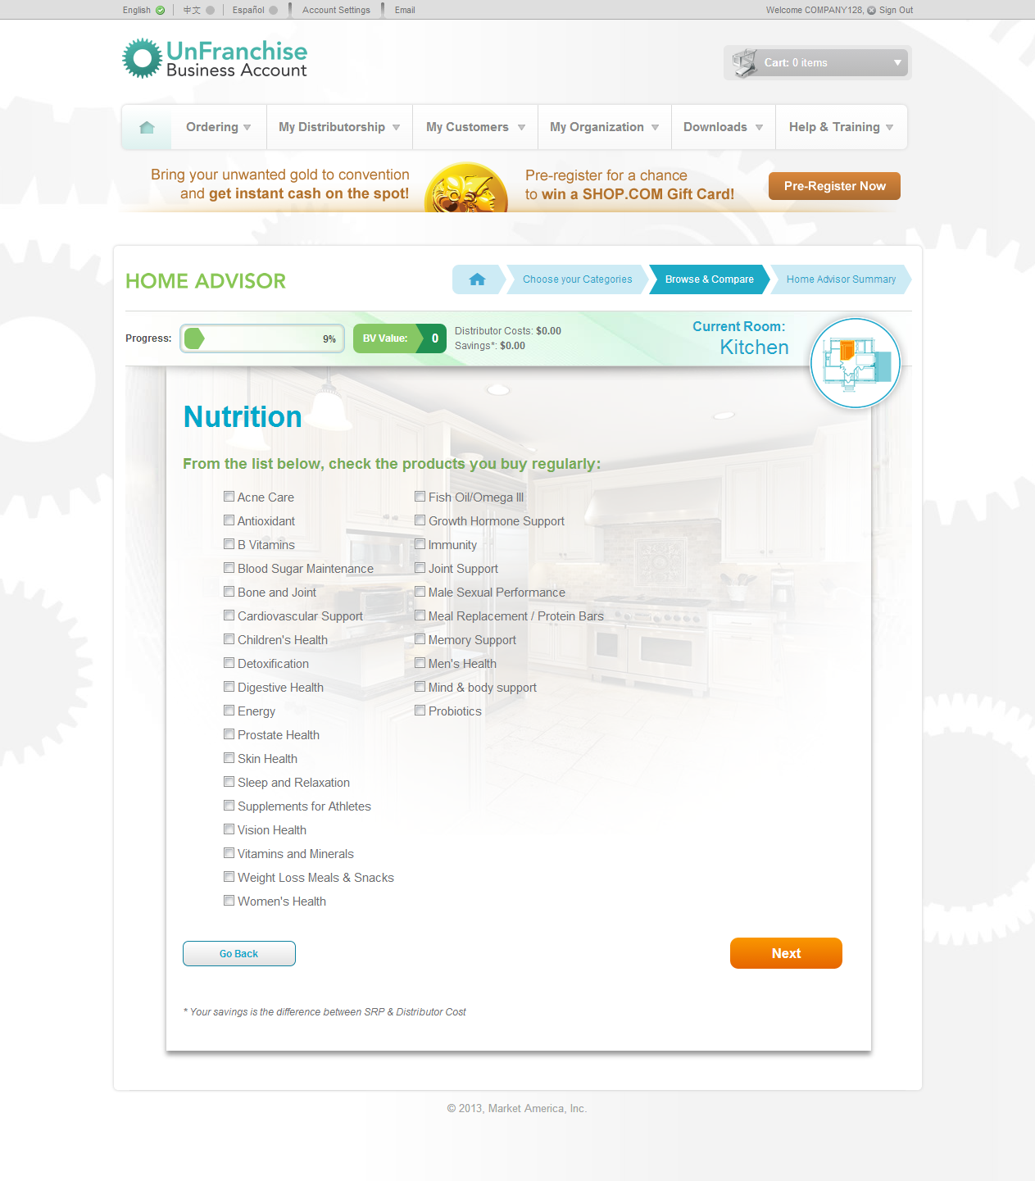

Slide 15
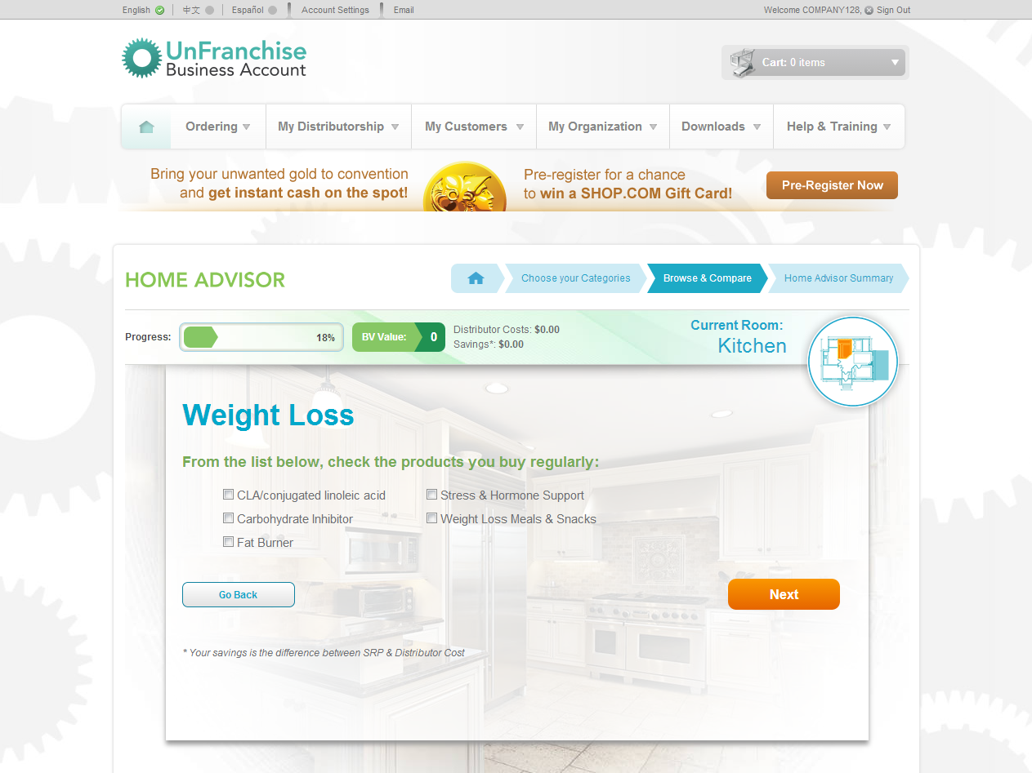

Slide 16
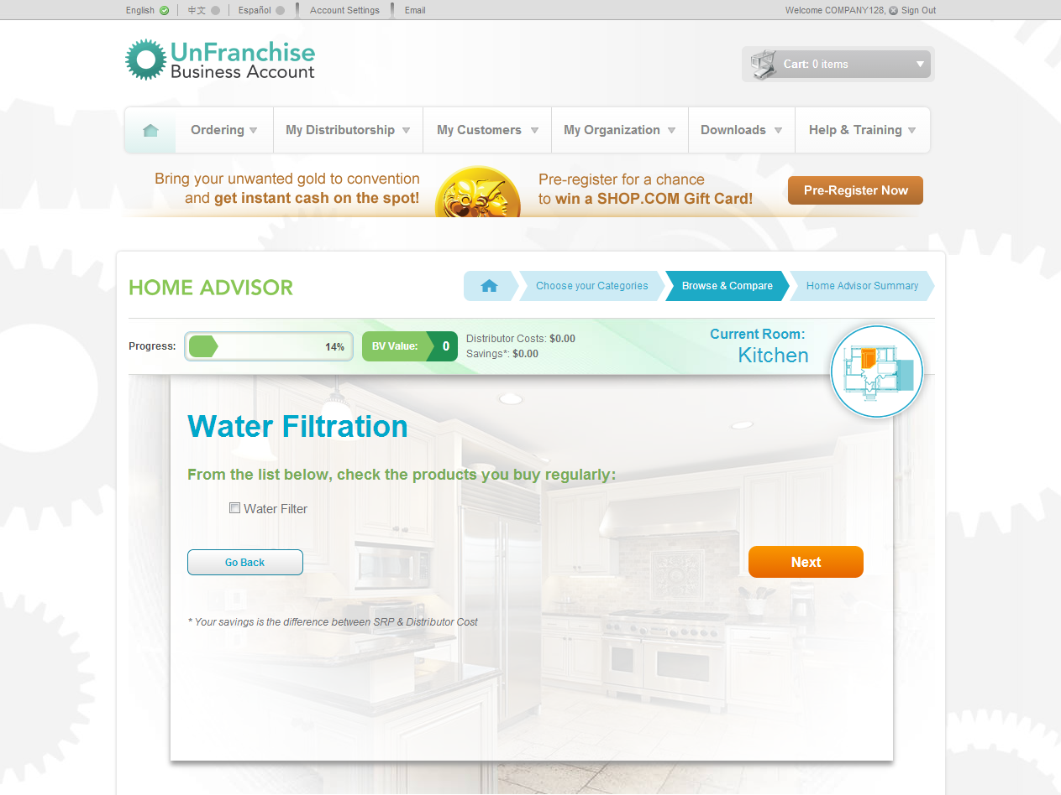

Slide 17
Negative Products
The Home Advisor
Now that you have identified all products you currently use in this room;
Selects the appropriate ma Branded Products based on your prior selections.

Slide 18
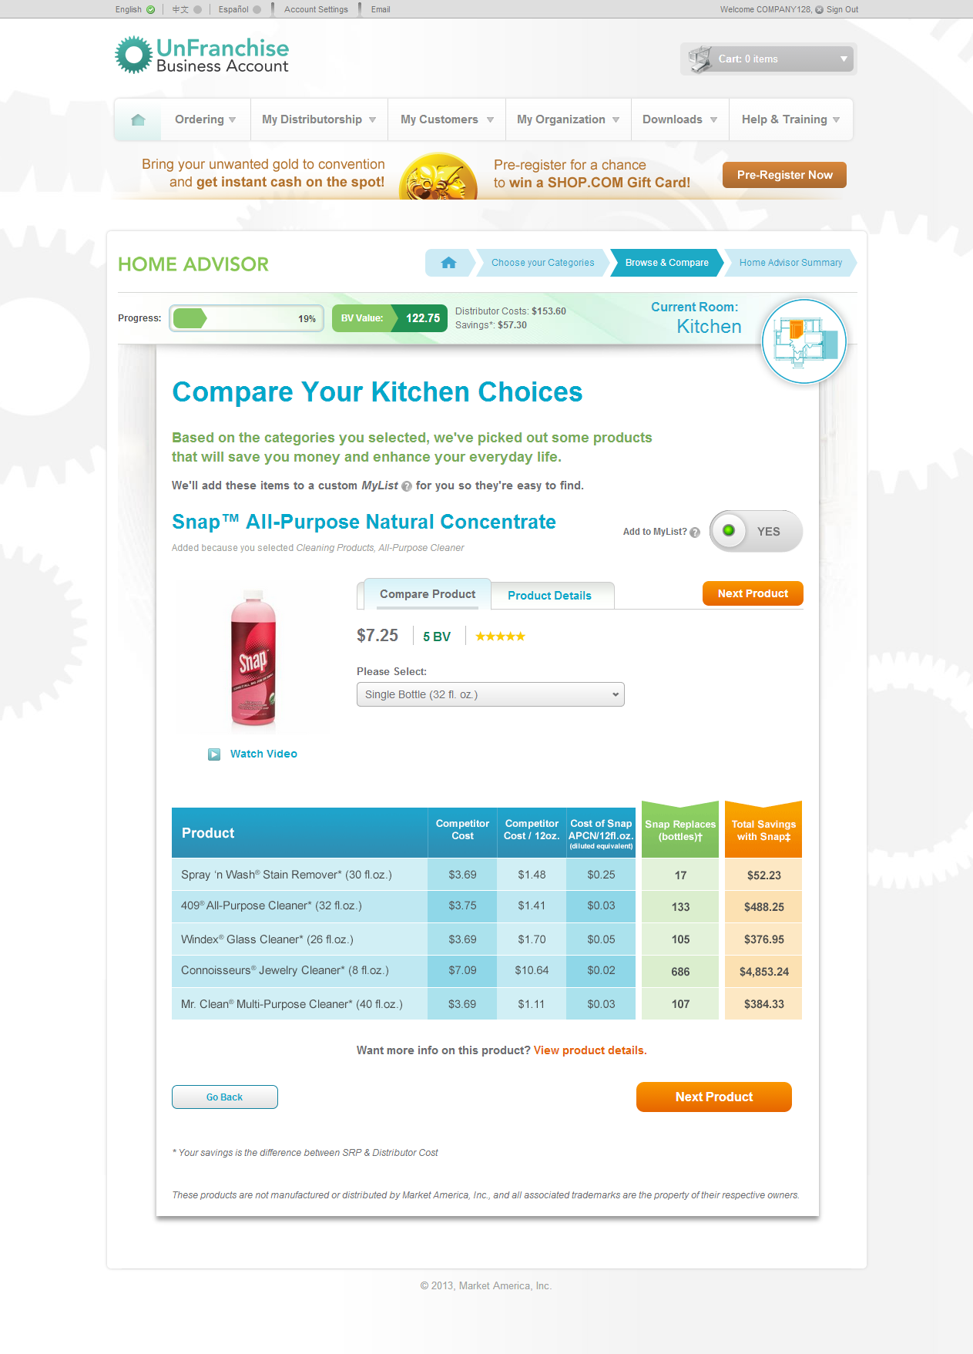

Slide 22
We Never Stop Improving
We are reducing the number clicks to complete the Home Advisor.
Making it a faster and easier user experience.
Leading to more products sold!

Slide 23
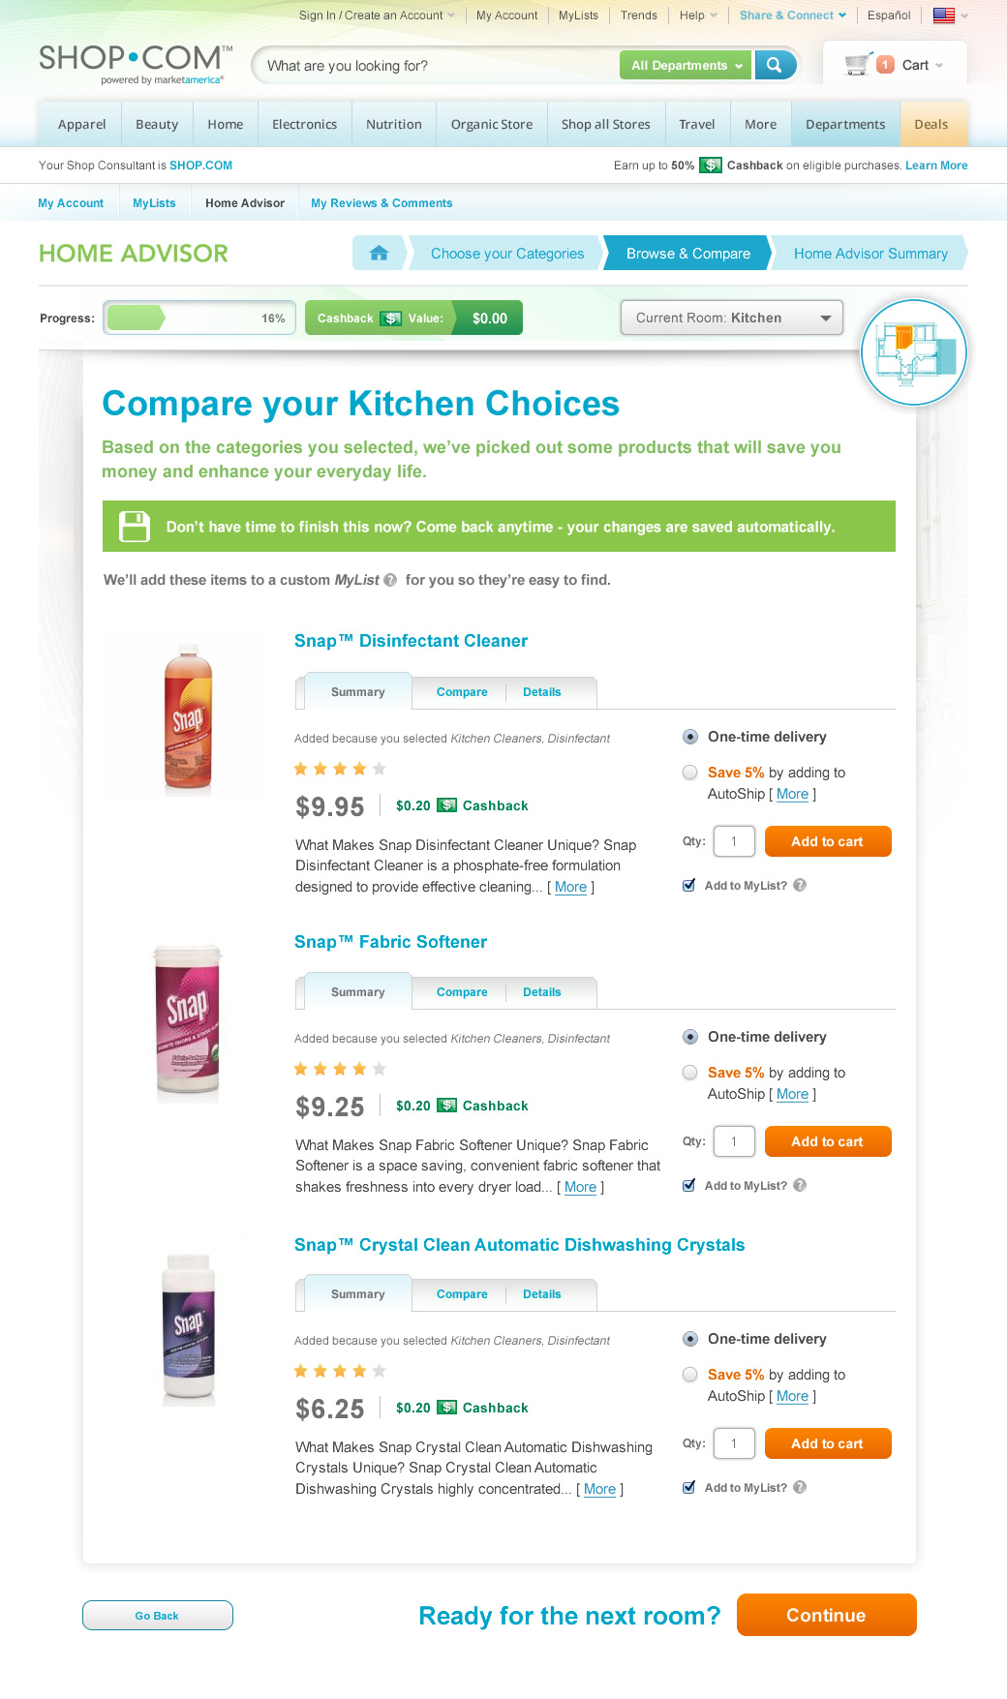

Slide 25
We save your progress! This way you do not have to start over!

Slide 26
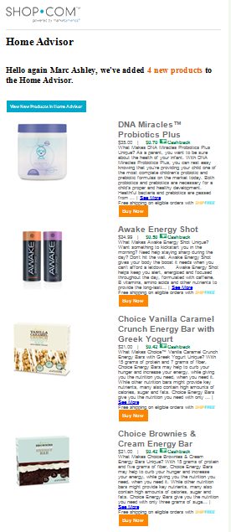
Also, if you have left the advisor, we will also alert you when new products have been added.
This was just sent today that shows some of the new convention products that have been added!

Slide 27
As you add products, the Home Advisor keeps track of your progress as well as your total BV and savings.

Slide 28
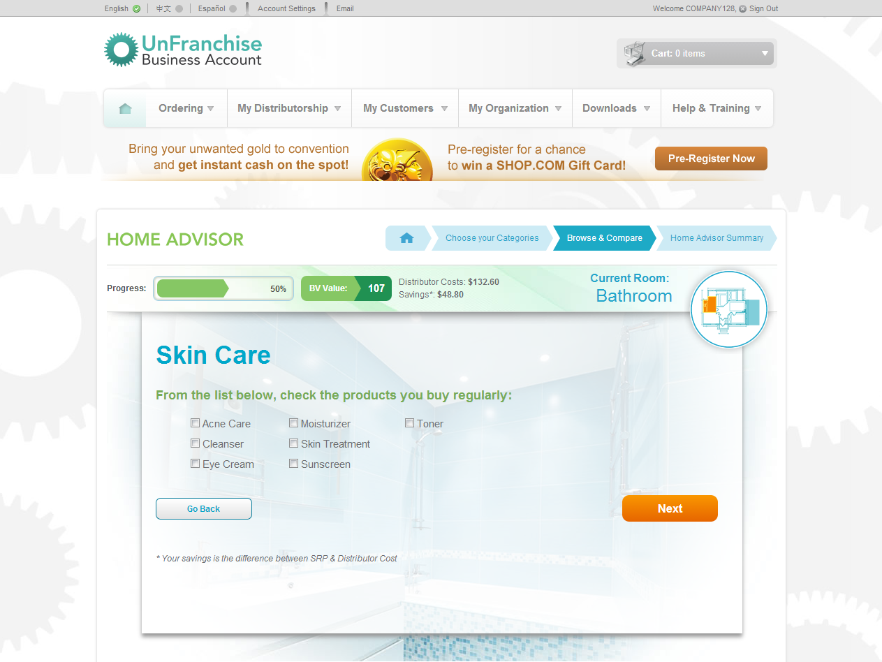

Slide 29
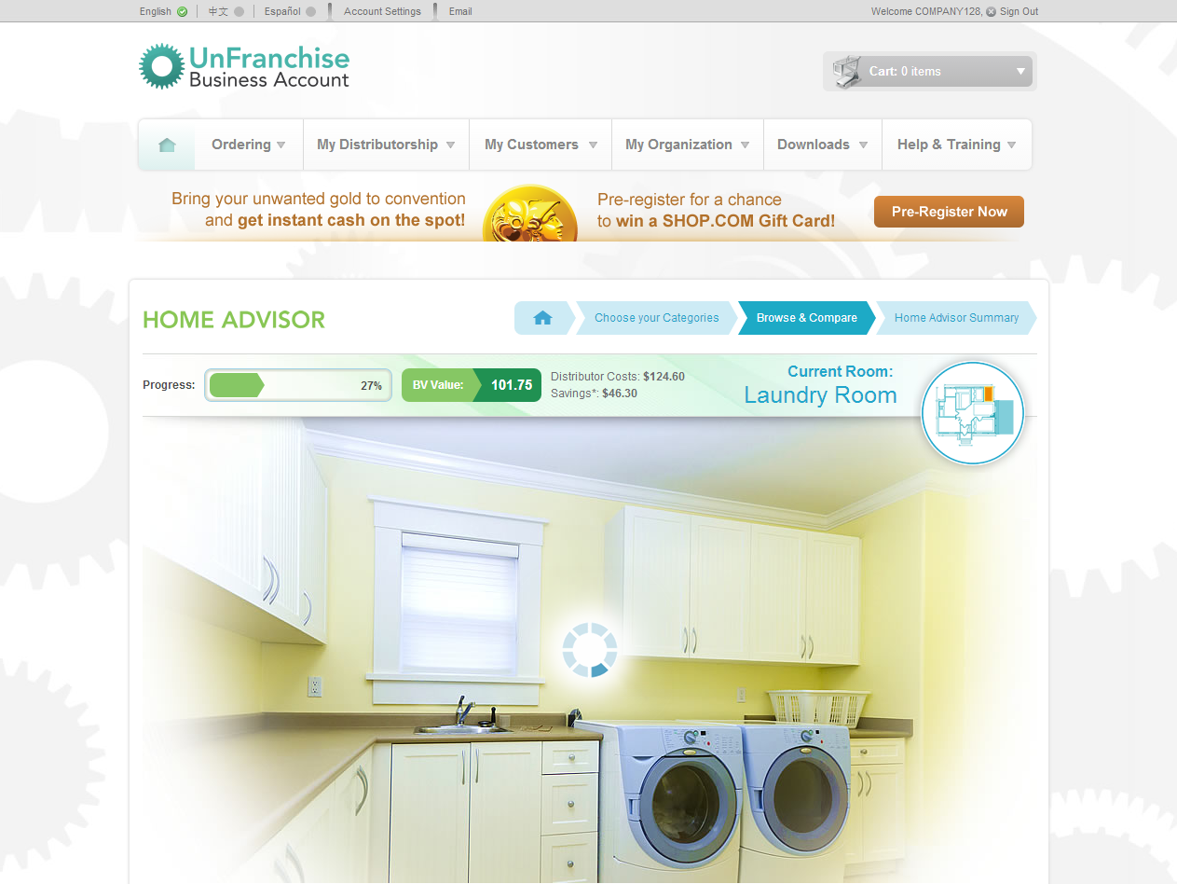

Slide 30
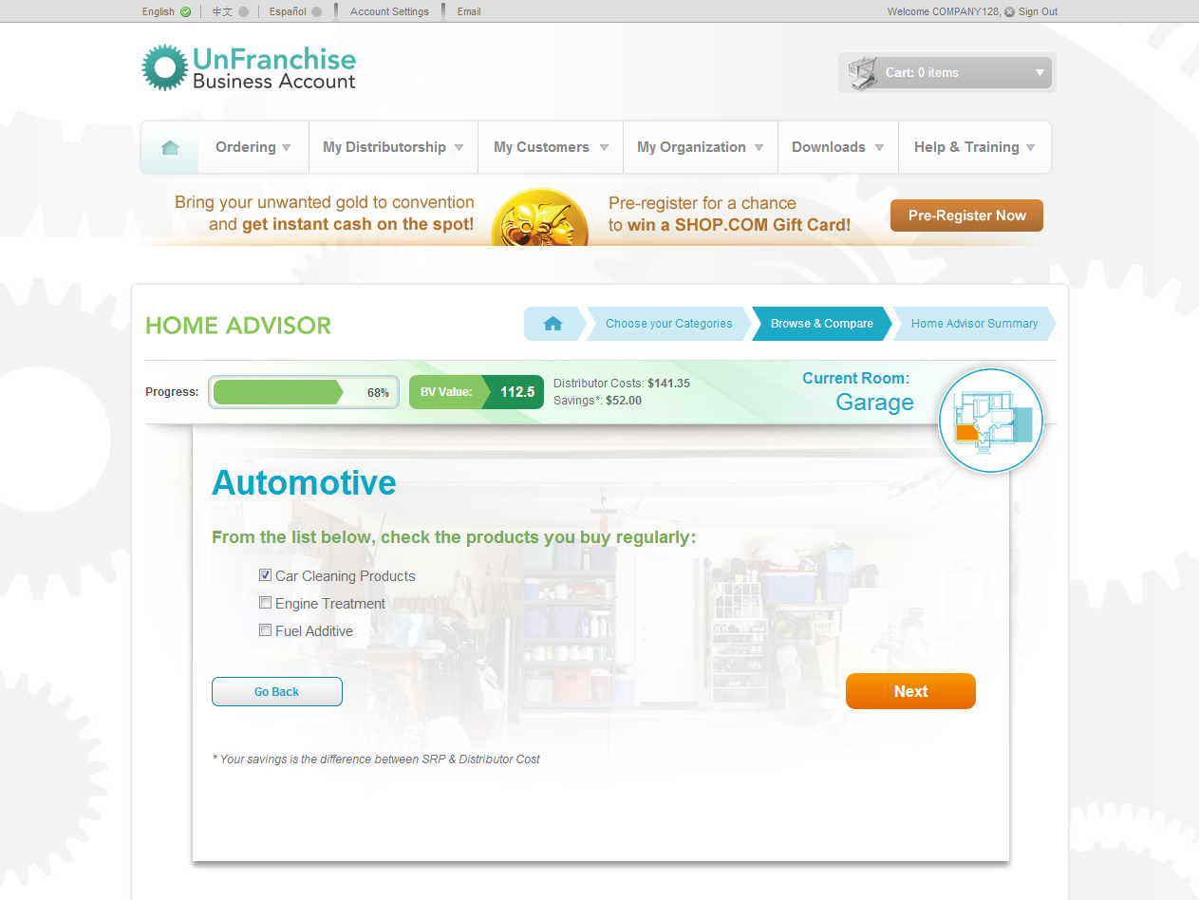
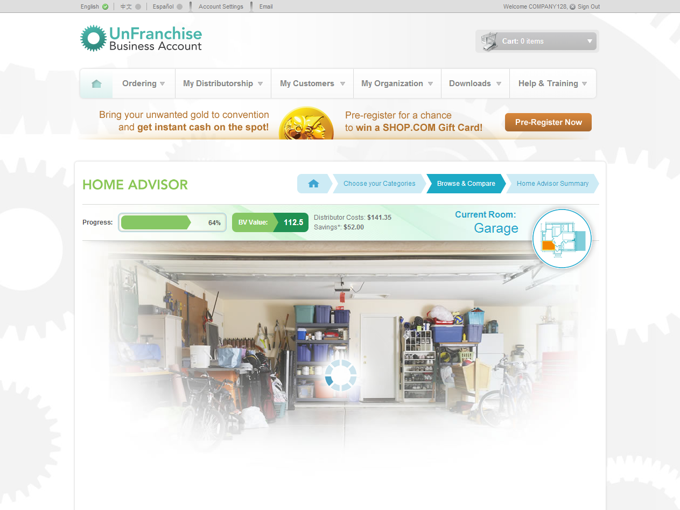

Slide 31
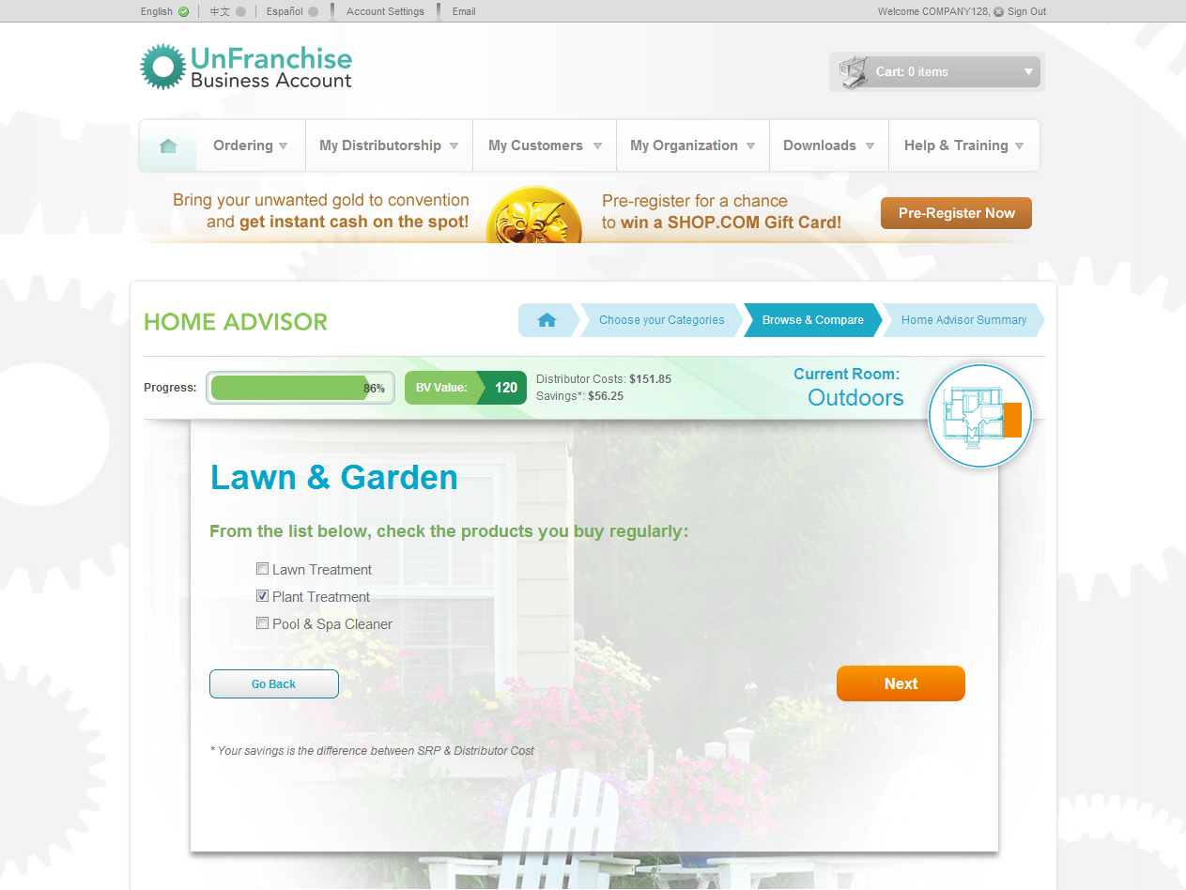
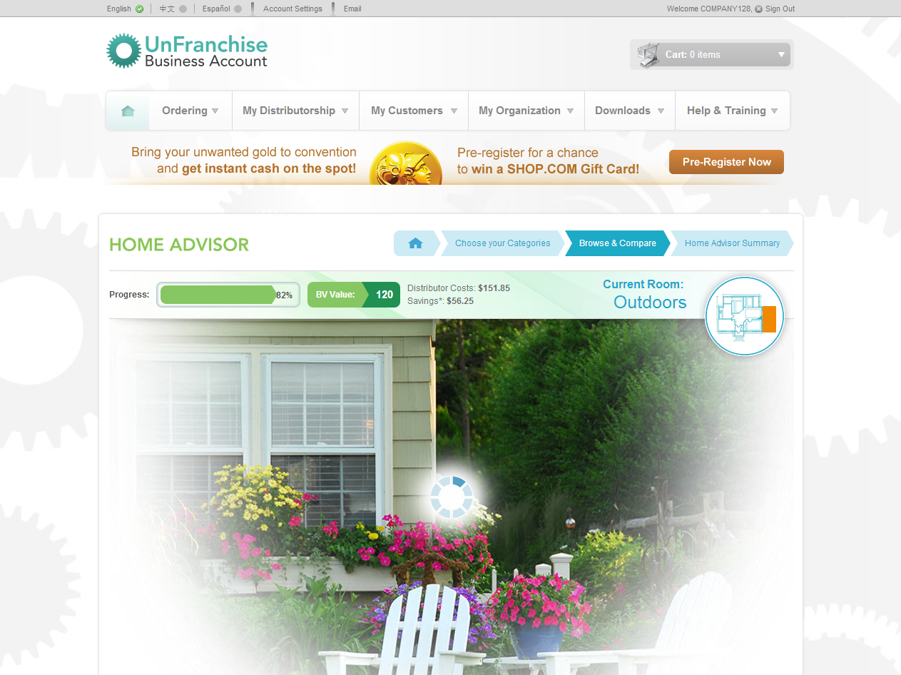

Slide 32
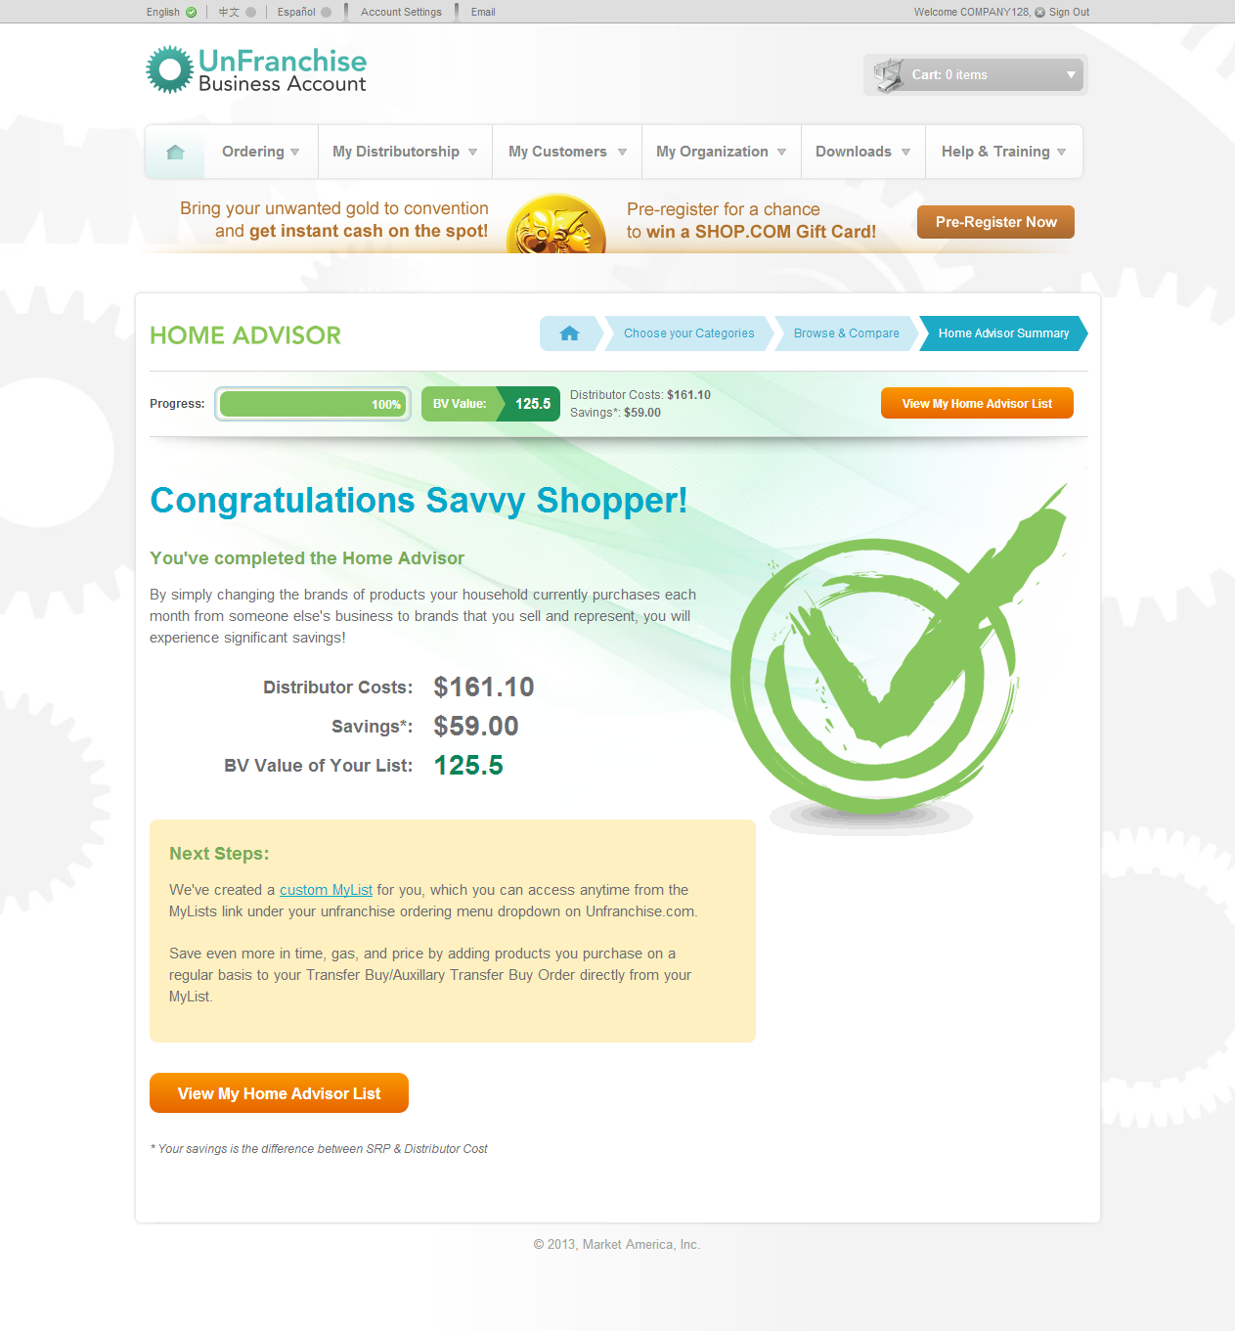

Slide 34
Now with your MyList built, quickly add your items to cart or add to your Transfer Buying Order in just one click!

Slide 35
Home Advisor
Your customers will experience the exact same home advisor on SHOP.COM as you do on UnFranchise.com.

Slide 36
The Difference Is
Your customers earn cashback
and save with the Auto-Ship program.

Slide 37
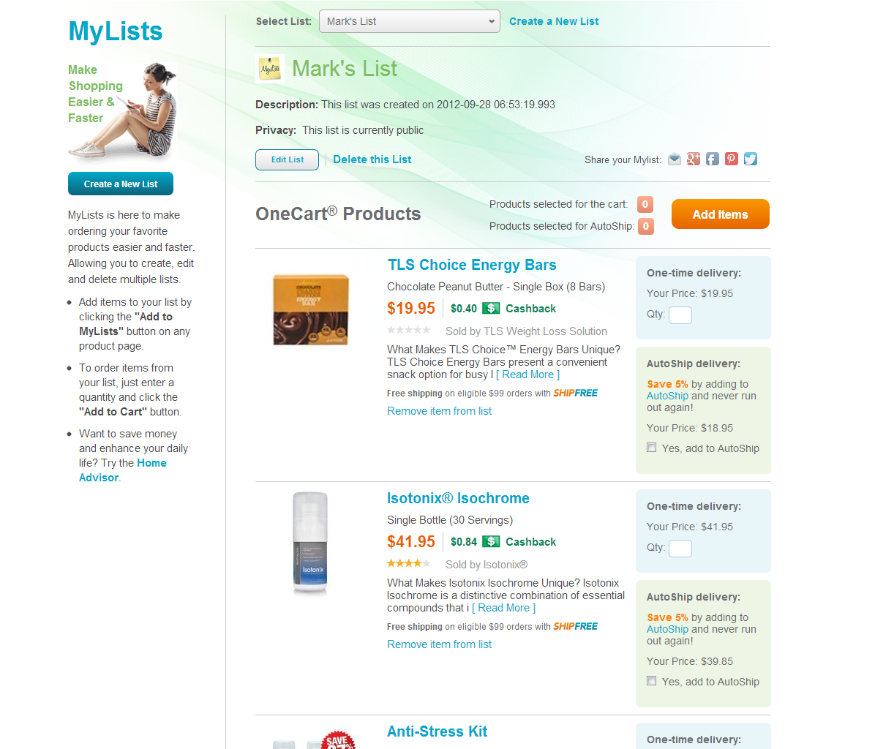

Slide 39
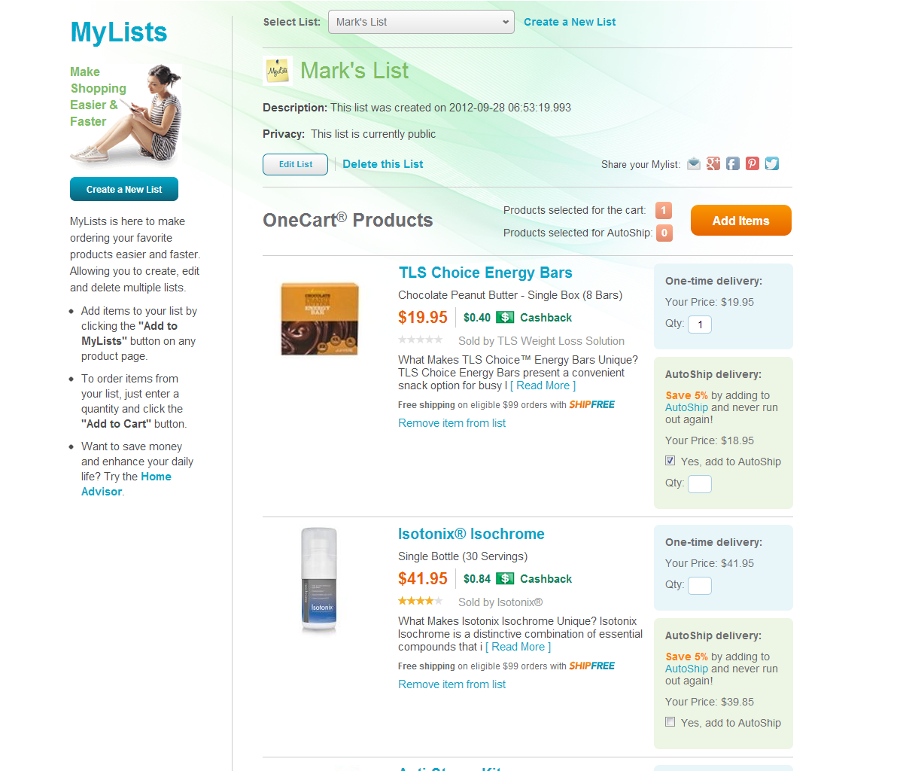
We have added the option to add to auto-ship from MyLists.

Slide 42
Imagine if we had most brands of consumable products available that you are already buying everyday
Next Steps

Slide 43
Consumer Packaged Goods
Market America / SHOP.COM is ENTERING, not partnering, in the consumer packaged goods industry.
Consumer packaged goods are home essential products such as cereal, coffee, trash bags, deodorants, tooth paste.
Basically all non-perishable items that you can buy in a grocery store.

Slide 44
Consumer Packaged Goods
Total retail sales in 2012 were $1.1 Trillion
Only 1% of consumer packaged goods are purchased online.
Market America / SHOP.COM are going to change that.

Slide 45
MA Online CPG

Slide 46
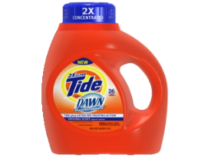
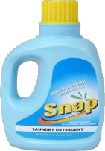
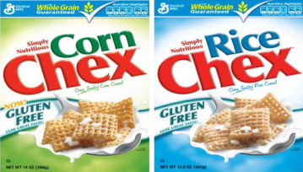
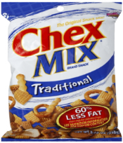
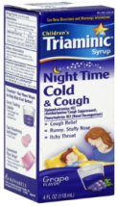
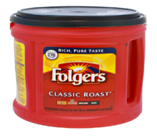
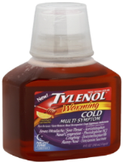
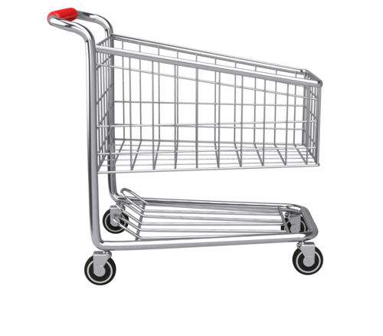
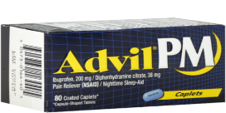
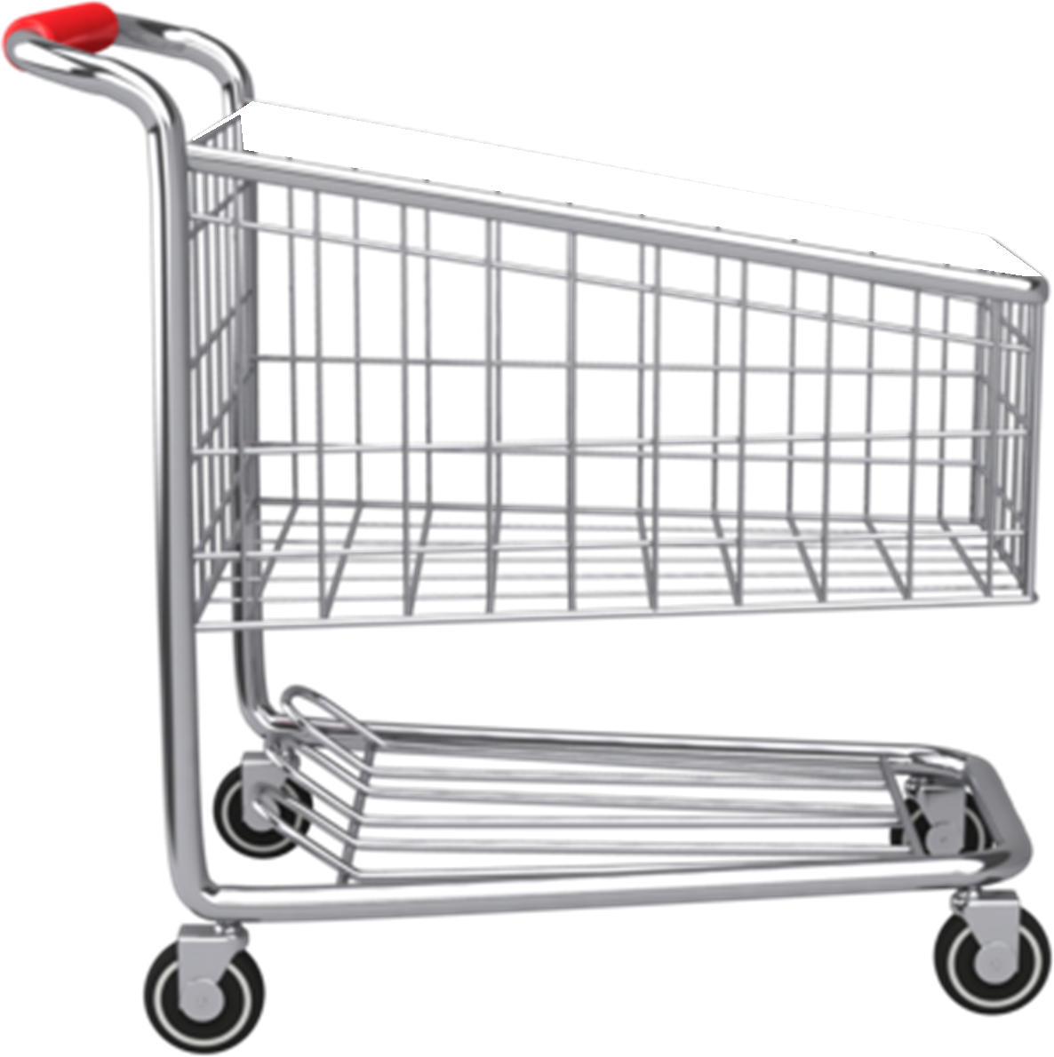
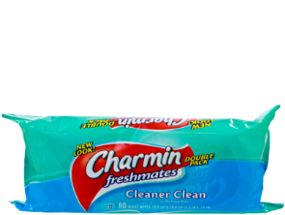
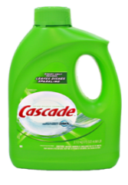
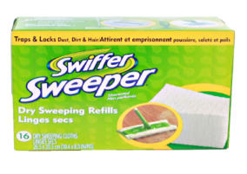
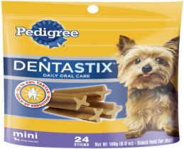
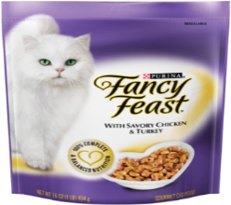

Slide 48
Shopping Annuity
Building out the Shopping Annuity. Transferring the CPG products they buy in the store and putting them on Auto-Ship / Transfer Buy.

Slide 49
Home Advisor
How would you like all of your distributors in your organization to go from averaging 150 BV and 30 IBV per month on Transfer Buying to well over 500 BV and 100’s of IBV per month?
You will have new distributors transfer all of the products added via the home advisor into one Transfer Buying order.
You and your organization will transfer all of products they buy on their transfer buy.

Slide 50
A New Simplified Transfer Buying

Slide 51
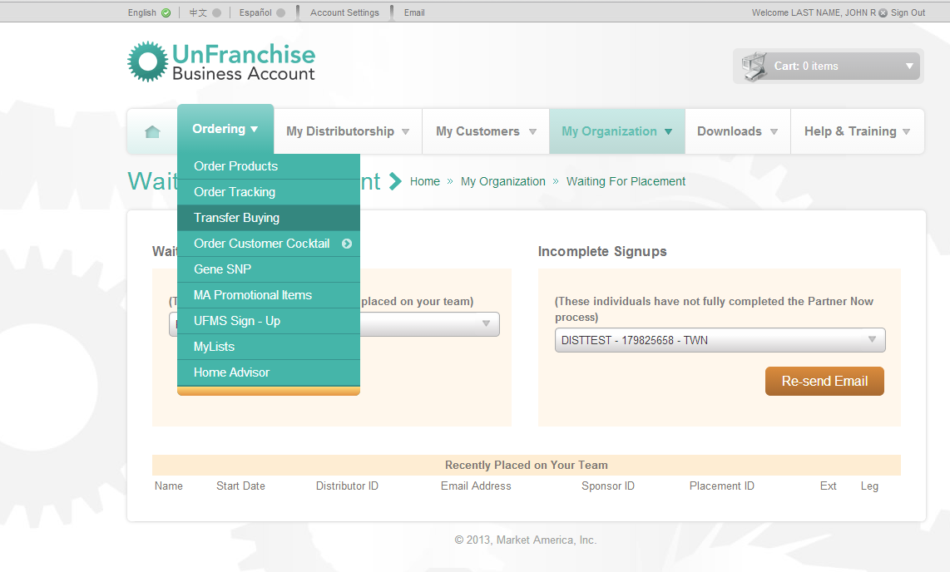

Slide 52
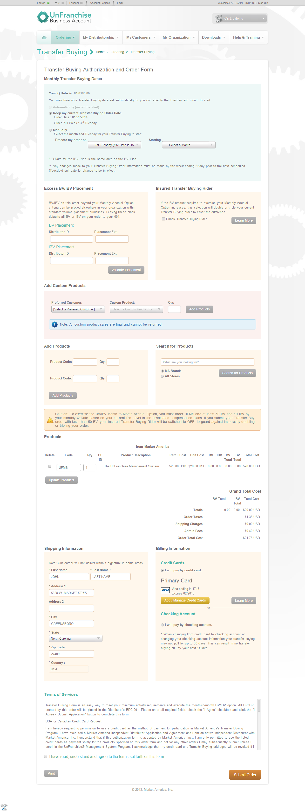
Now Live: We have added a quick and easy product search on your Transfer Buy form.
Now Live: You can add as many products to Transfer Buy and place all excess BV/IBV into an additional BDC/IBDC.

Slide 55
RECAP
Online Home Advisor
Products you purchase everyday
MA Brands
Online CPG
Purchasing directly from the wholesalers / manufacturers
Much Higher cashback & Higher IBV
The New Transfer Buy

Slide 56
We Are Not Stopping There!
There are some additional opportunities to make Transfer Buying even better and solve some additional challenges.
Spreading your Transfer Buying over 4 weeks

Slide 57
Is there anything else we can do next to incentivize?
Do we offer Free Shipping on Transfer Buying Order
New ways to qualify and simplify the bonus pool – over 500,000 IBV to be given away each quarter.

Slide 58
How many of you hate the 5th week pull?
Your transfer buy will pull every 4 weeks.
5th
WEEK

